Slide 1
Merge vs Append
Merge vs Append

Slide 2
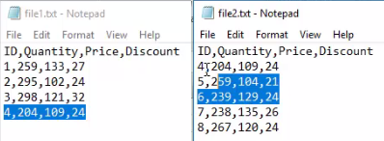
Merge vs Append
Note: This Lab uses the file File1/2/3.txt which are located in the resources Multiple Files\Files
Search the two files File1.txt and File2.txt in the query editor
Check if both files have the same data structure
Note that there is a line in common between the two files

Slide 3
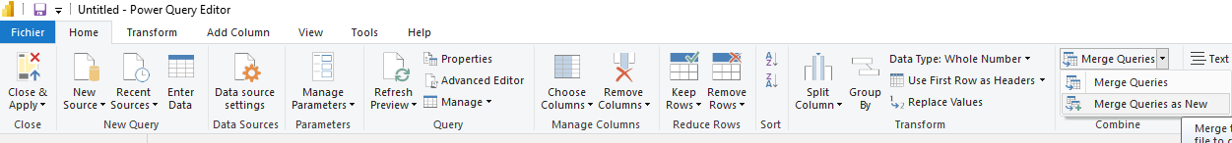
Merge vs Append
Select Merge Query as New from Merge Queries on the tab Home

Slide 4
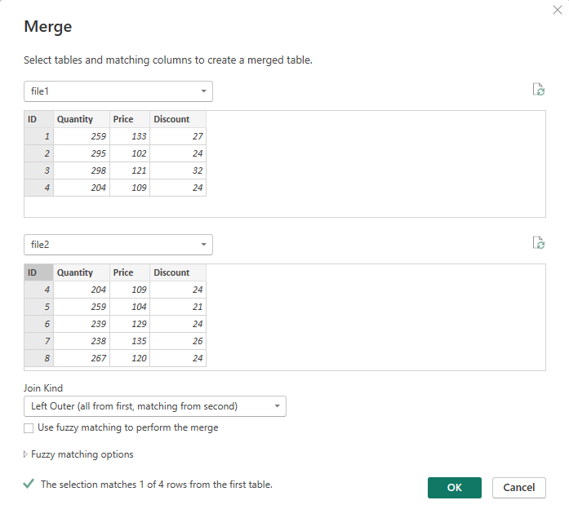
Merge vs Append
Select both ID columns and notice that the OK button becomes active

Slide 5
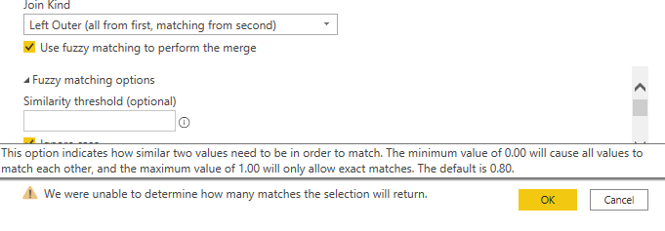
Merge vs Append
Test this example with all possible join types
Notice the Fuzzy feature matching options , this option is used in case the two columns in common do not have values that are exactly equal but rather similar
Note that the degree of similarity is between 0 and 1 and the relative default value is 0.8
Repeat the same exercise with Append as New and notice the difference in the output level

Slide 6
Thank you
Thank you

